Slide 1
Developing and supporting positive behaviours with transformative training
Trainers Network Meeting
Hosts Name: Nick Burnett
Date: 20th February 2023
Notes:
Core (C) All Team Teach Level 1 and Level 2 training courses cover:
C1. Team Teach warm up and team building activities.
C2. Values - keeping people safe and happy - what if that was your child, relative or friend?
C3. Understanding Emotions & Behaviours that Challenge - how do we behave and what can we do better.
C4. Personal space, body language, circles of danger, safe stance and calm stance and scripts.
C5. Help Scripts, The Conﬂict Spiral - Stages of Crisis - Post Incident Learning and Support, understanding the processes.
C6. Issues following training, Risk and Restraint Reduction Planning - for organisations and individuals.
C7. The Legal Framework - policies, guidance, recording, reporting and planning.
C8. Elevated Risks, Knowledge Quiz, De-escalation Scenario or Positive Handling Plan Activity.

Slide 2
Acknowledgement of Country
I would like to begin by acknowledging and paying my respects to the Traditional Custodians of the land we are each gathered on today.
I would like to pay my respects to their Elders, past, present and emerging, and acknowledge all Aboriginal and Torres Strait Islanders here today, paying my respect to your Elders, past, present and emerging.

Slide 3
Karakia
Kia hora te Marino
Kia whakapapa pounamu te moana
Hei huarahi mā tātou i te rangi nei
Aroha atu, aroha mai
Tātou i a tātou katoa
Hui e! Tāiki e!
May peace be widespread
May the sea be like greenstone
A pathway for us all this day
Let us show respect for each other
For one another
Binding us all together!

Slide 4
Agenda
Updated Slides
Legal and Policy Updates
Feedback about techniques taught
Supporting videos
Delivery Options
What’s on the horizon in 2023
Reaccreditation
Connect with us on LinkedIn

Slide 5
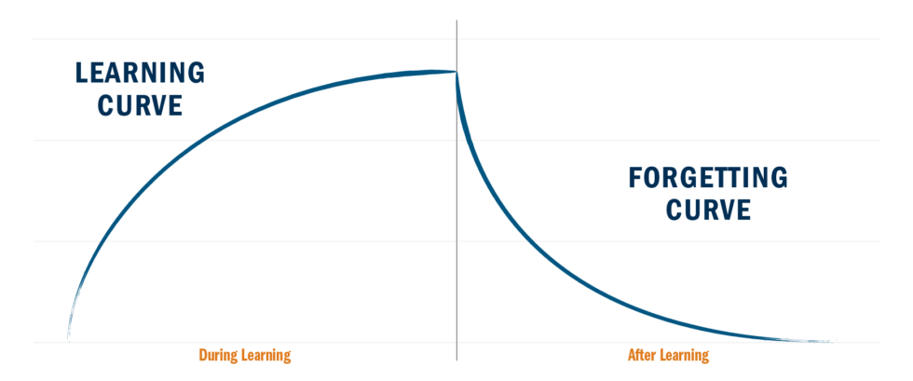
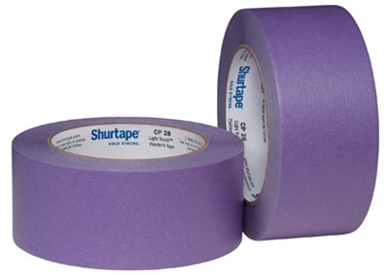
Making the new learning stick
Notes:
What's been most useful here for you? Who has ideas they'd like to apply when they get back to work?
"This is the most engaged you'll be with the content, while your knowledge of it is freshest"
"We/I want to help you bottle those good intentions and make them last longer."
"Leverage the time you've invested here today to make a lasting change in how you work"

Slide 6
Tasks versus Habits
things to “complete”
(single application)
things to “improve”
(ongoing application)
Notes:
Takeaways from days like today are typically two-fold: tasks (things to "complete") and habits (things to "improve")
Exercise: organize by Tasks (marked with T) and Habits (marked with H)
Discuss: Who has more tasks that habits? (That's pretty normal) Who has at least one habit? Willing to share what it is?
The power of including a focus on a habit is that the benefit of our time together here today will be long lasting. You'll "level up" for lack of a better term.
Tasks are fine and normal, but they rarely have lasting impact. We want lasting impact.
So choosing a habit is an important first step. How we craft that commitment to habit change is as important.

Slide 7
Crafting Good Habit Commitments
Trigger
Current Habit
New Habit
“When X happens,
Instead of Y,
I will Z.”
Trigger
Behaviour based
Location based
Time based
New Habit
The “laughably small” first step
Make it specific
Current Habit
The thing you’ve trained yourself to normally do.
Notes:
"Who here sets or has set a New Years' Resolution in the past?"
According to a study done by the University of Scranton, 92% of New Years' Resolutions "fail" by January 21st.
Why do you think that is?
They're too vague, they're too lofty, there are too many set at once, they fail to take "reality" into account, too much work, etc.
"So, what makes a good habit commitment?"
There's a Behavioral Psychologist at Stanford named BJ Fogg, who is well regarded as the global subject matter expert on Habits. Or what we might call behaviour change. And, based on about 30 years of research, Fogg says there are 3 core components to structuring a good habit commitment; something that we're substantially more likely to achieve.
1. Trigger
2. Current Behaviour
3. New Behaviour
{Unpack "Trigger", "Old Behaviour" & "New Behaviour”}
Trigger - time, location or activity based (or ideally all three)
Current behaviour - not necessary "bad", just the thing you're normally hard wired to do.
New behaviour - the thing you want to do instead.
Should be "laughably small". The tiniest first step.
Flossing example
have some examples ready based on the content… they should also, ideally, be the same examples you pre-populated into the pre-built commitments
“Who wants to workshop one of their habit commitments?”
“Who feels they have a strong commitment now? One that matters to them, that is anchored in a trigger and a first step that is small enough to ‘laughable’?”
It’s ok if you don't yet; I'm going to give you a couple pre-built commitments, based on today’s content, that might make it easier for you.

Slide 8
Setting Yourself up for Successful Habit Change
Choose an “Accountability Buddy”
Likelihood of implementing a concept:
10% if you hear an idea
25% if you decide to do it
40% if you decide when you're going to do it
50% if you plan how you're going to do it
65% if you tell someone you're going to do it
95% if you set up a time to report back to that person on how you did
Data from 2009 Global Study conducted by the American Society of Training & Development
Notes:
“Who could be your accountability buddy?”
Co-worker, manager, someone from this session, spouse, friend, etc.
It ultimately doesn't matter who it is, so long as it's someone you respect and will feel accountable to.

Slide 9
Setting Yourself up for Successful Habit Change
Three tools to set yourself up to succeed
1
2
3
Organise regular reminders and check-ins on your progress
Engage in structured reflection 20-40 days later
Choose an
Accountability Buddy
Notes:
Crafting a clear, well structured commitment is a critical first step in creating a new habit. But there are a couple other helpful pieces as well; things that will make it easier for you to achieve the change you want to see.
Accountability Buddies
Regular reminders & "check ins"
Structured Reflection

Slide 10
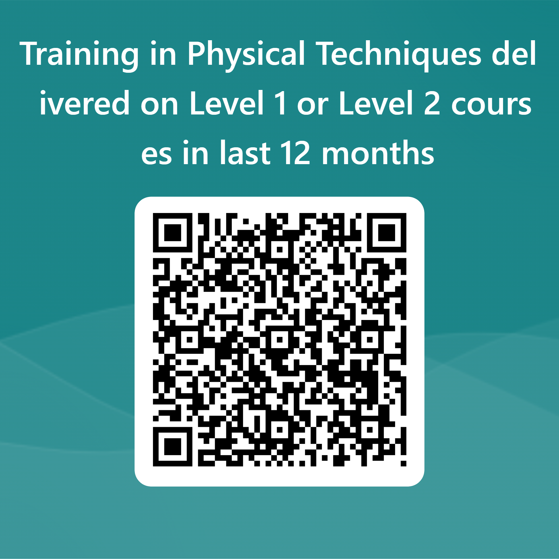
Training in Physical Techniques delivered on Level 1 or Level 2 courses in last 12 months
Notes:
https://forms.office.com/r/QBgPP70XTe

Slide 11
Delivery Options
Level 1 – 6-hours
All F2F – whole day
All F2F – 2 x ½ days
All F2F – 3 x 2 hour twilights
Blended – 3 hours online + 3 hours F2F
Level 2 – 12 hours
All F2F – 2 x whole days
All F2F – 1 x whole day + 2 x ½ days
All F2F – 6 x 2 hour twilights
Blended – 3 hours online + 9 hours F2F
Level 1+ - 6 hours plus x hours dependent on physical being taught

Slide 12
What’s new in 2023?
Notes:
New TT platform

Slide 13
Notes:
New TT platform

Slide 14
Notes:
New TT platform

Slide 15
Notes:
New TT platform

Slide 17
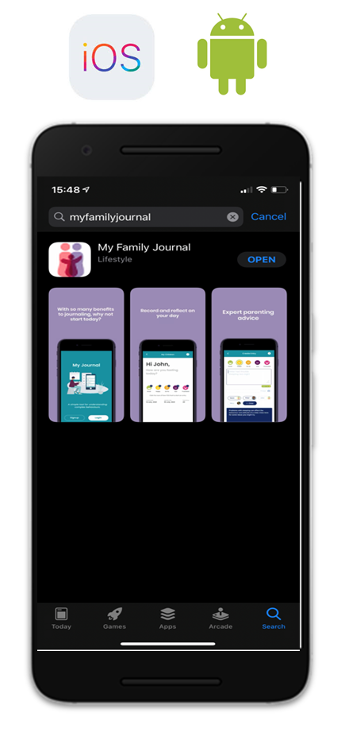
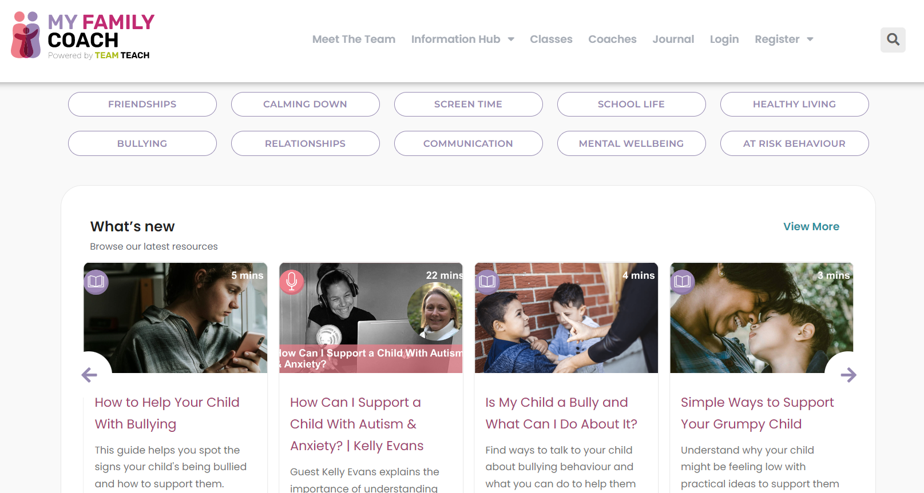
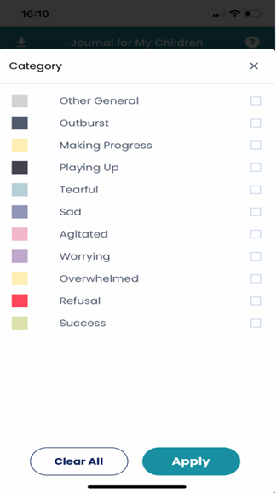
My Family Coach & My Family Journal App - Powered by Team Teach
At Team Teach, we help all staff deal positively with issues ranging from anxiety and stress to bullying, peer pressure and online safety, among many different forms of communication. But we also know that behaviour challenges don’t end when the school day does, which is why we have launched My Family Coach.
A free resource for parents to connect the dots between behaviour challenges that may be displayed in school or college but that may start or continue into homelife. www.myfamilycoach.com
We are creating a bridge between teachers and parents and between schools and homes
Journal - A free app for you to give to parents to help them understand the triggers and patterns in their children’s and young adults lives.
Notes:
Webinar involvement - PBL interview

Slide 18
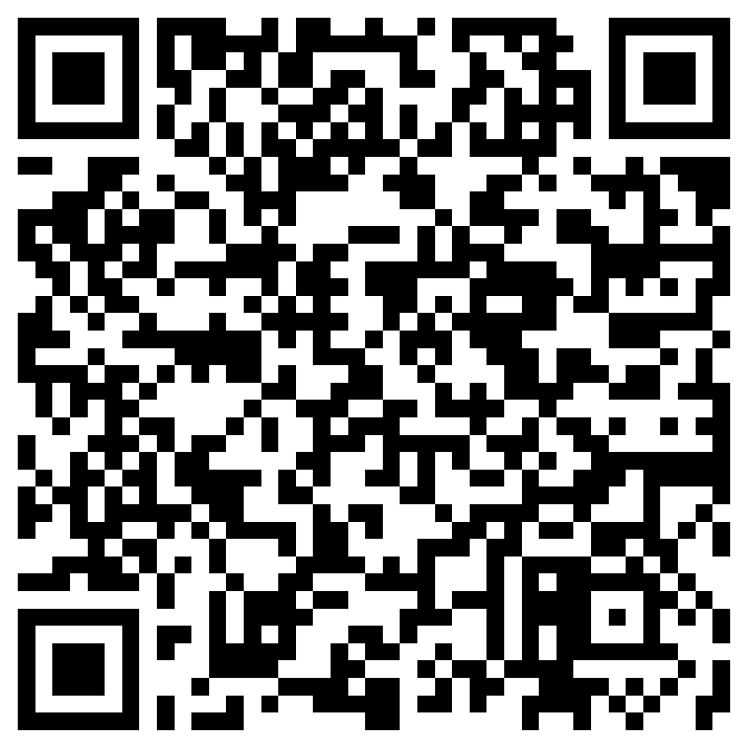
Potential new professional learning opportunities
Coach Training - online course available to support and develop your coaching skills to sit alongside and be supplemented by your knowledge of Team Teach.
Sex and Relationship Education - a virtual train-the-trainer course has been developed by Paul Bray in the UK as delivery of this is required in special schools in the UK.
‘Restorative Practice and Special Needs A Practical Guide to Working Restoratively with Young People’ - on-line course to support knowledge and implementation of the ideas contained within the book.
Mojo-Maintenance Train the Trainer Program - Mojo-Maintenance Training (MMT) is designed to enable participants to train colleagues back in their setting in the use of “peer reflective practice” tools to help staff support each other in:
taking stock of the impacts of the challenging situations they face daily, and
sharing ongoing learning about their own resilience and self-regulation.
Notes:
https://forms.office.com/r/bf535Nd2JT

Slide 19
Advanced Techniques
Ground fights
Ground assaults
Transport
Dead-weight responses
Ground recovery holds
Weapons
Modular opportunity

Slide 20
Reaccreditation Timescale
Team Teach Course | Recommended | Required
Level 1 (Low Risk Settings) | Every two years | Every three years
Level 2 (Medium to Elevated Risk Settings) | Every year | Every two years
Foundation Trainer | N/A | Every 12 months
Intermediate Trainer | N/A | Every 12 months
Advanced Trainer | N/A | Every 12 months
All refreshers are required to be a minimum of 50% of the length of the original course with no more than 50% of Level 1 or 2 refreshers being on the techniques

Slide 21
Requests for Trainer extensions
Team Teach will still grant extensions for Trainers who have:
Maternity Leave
Long Service Leave
Are away from work due to long term sickness or have sustained a injury
To be granted an extension if any of the above apply you must email Nick.burnett@teamteach.com.au and info@teamteach.com.au
Nick will confirm back via email to the Trainer
Notes:
Email request to Nick directly (eg LSL, maternity leave)
Nick will reply to the tutor and cc Sarah/Pania

Slide 22
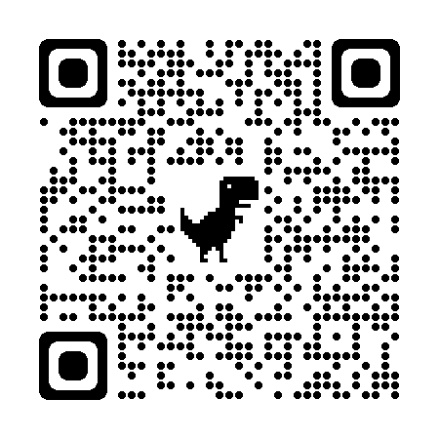
Keep in touch
Follow us on LinkedIn to get the latest updates, newsletters, case studies, interviews and other useful information.
Just scan the QR code and start following the Team Teach Australia & New Zealand company page…. We would also appreciate any comments from your Team Teach training experience.

Slide 23
Karakia to close

